Slide 1
Patch Pocket Tutorial
You will need –
Fabric, a ruler (see through plastic is best), a sewing machine, an iron, pins, scissors, paper and pens.
Some tips –
Wash fabrics before sewing to prevent shrinking when washed. Read all the instructions before sewing! Make sure you cut the pattern with the right grain of the fabric. This is very important if you are using stretchy fabric. The stretch should go from side to side, not from top to bottom. Use a new, sharp needle in your sewing machine. If you are sewing with stretchy fabric, it’s best to use a jersey or ball point needle. These are made especially for stretchy fabric and will minimize snagging or thread tension issues. Use more pins if you need to and sew slowly.

Slide 2
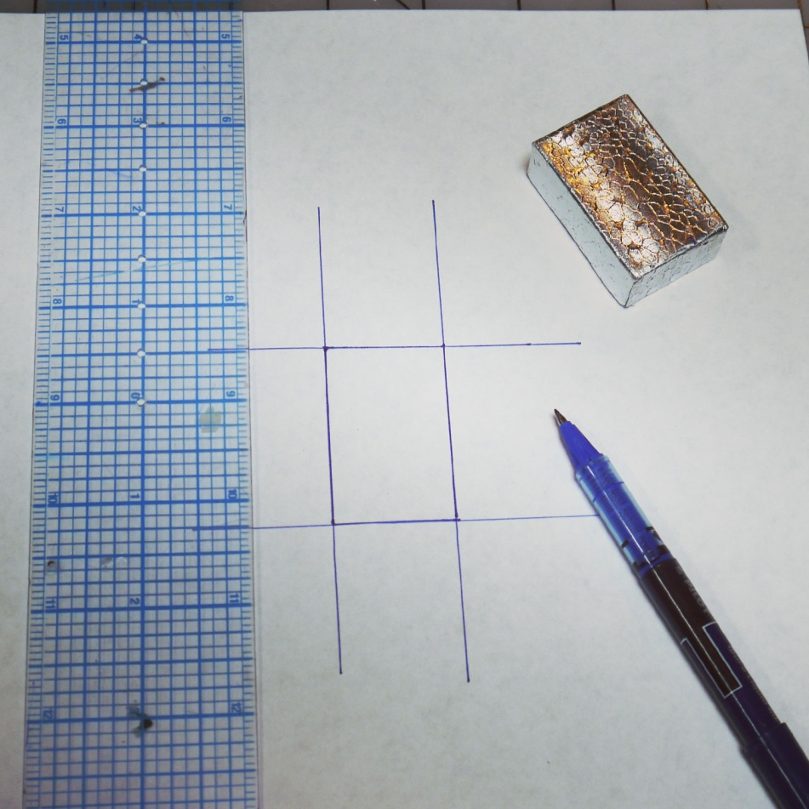
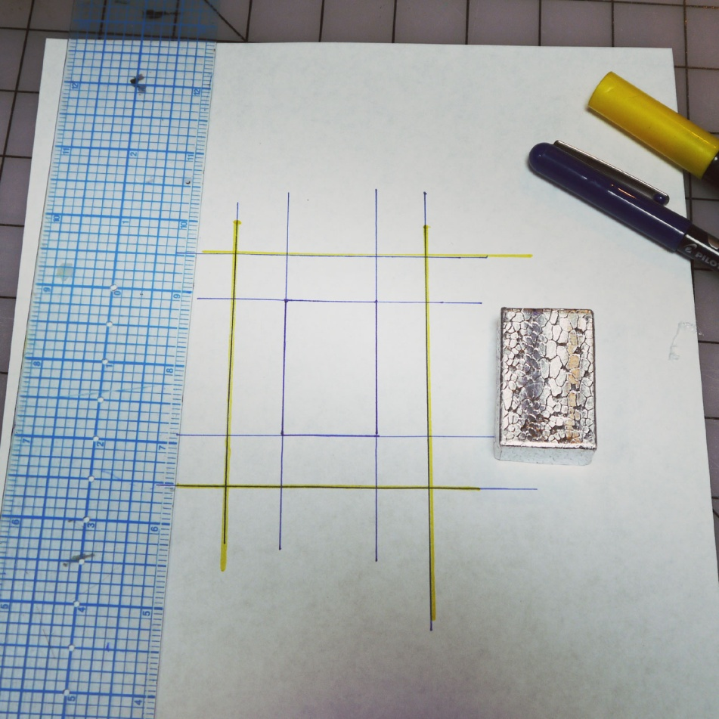
1.
Make a pattern for your pocket. If you need to fit a specific object inside of it, this is how you do it. Measure the length and width of your object and draft a rectangle with these measurements onto a piece of paper. Use a ruler and make sure to square off your edges into right angles so that it isn’t crooked. Extend the lines out as shown.
2.
Now measure the depth of your object. If it is flat, this won’t be much. If it’s very deep, we will need to add ex tra space to the pocket. Add the depth measurement around all sides of your rectangle using the ruler. I’ve marked the new lines in yellow here.

Slide 3
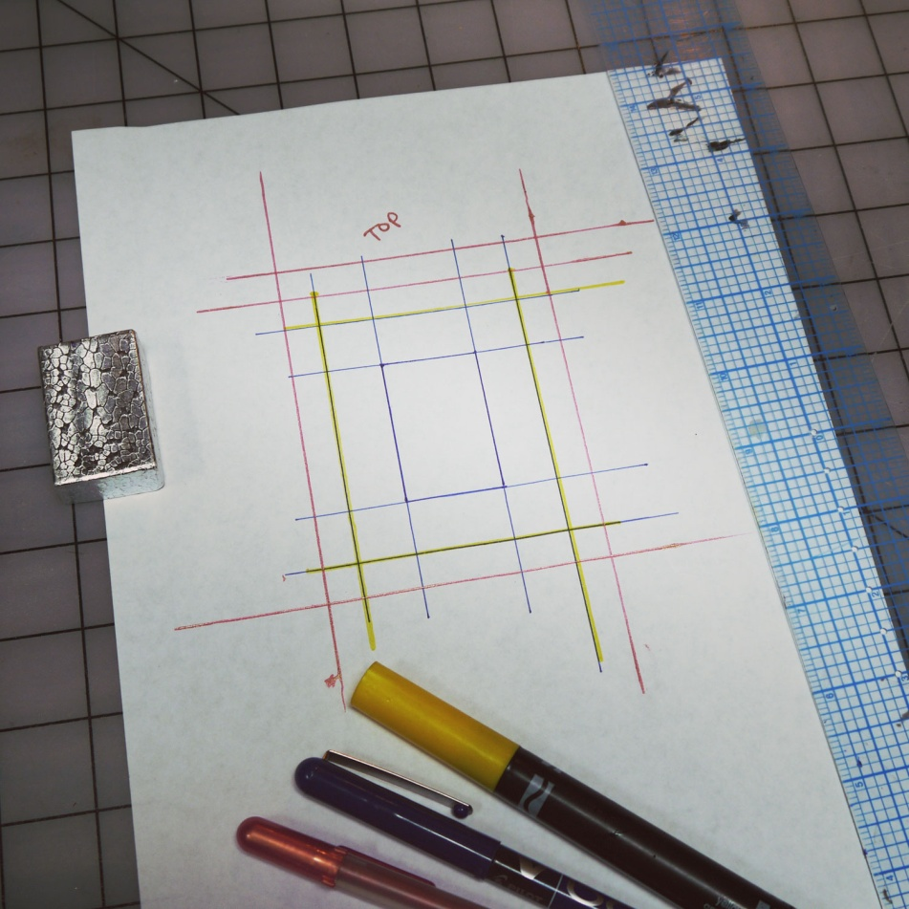
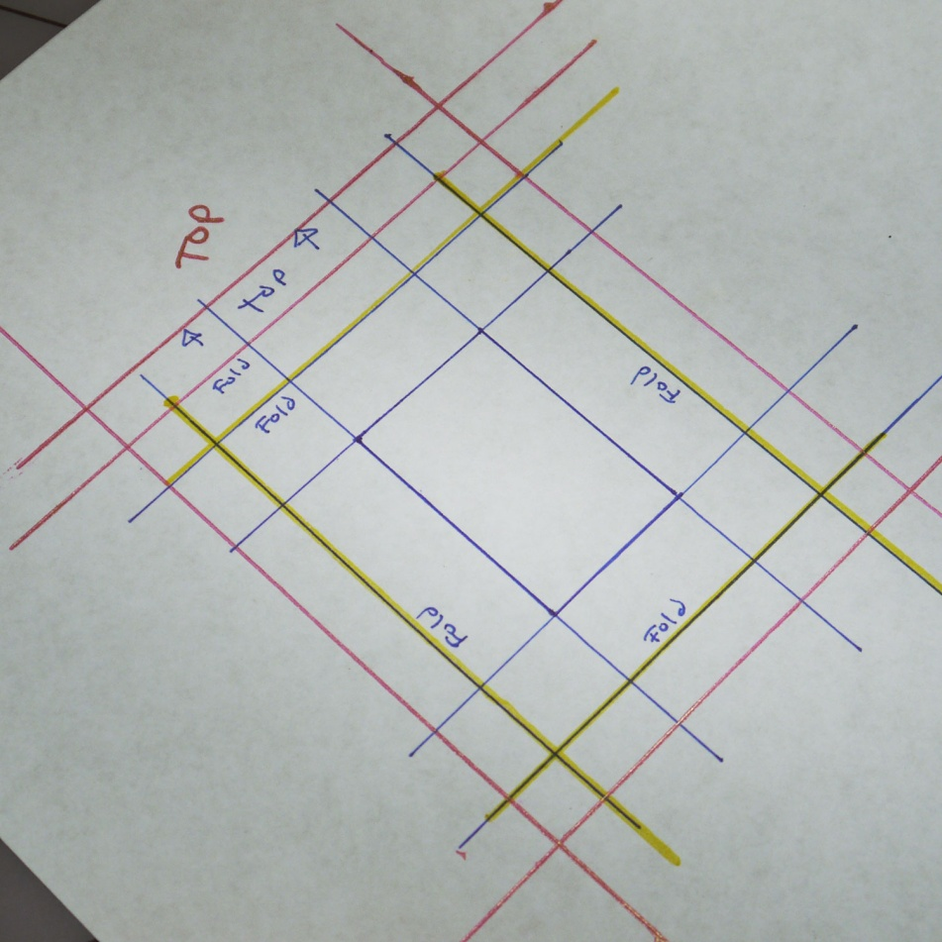
3.
Now we are going to add seam allowances. I use 3/8 of an inch. Add this amount all around the outside of the last set of lines. I’ve made the lines here in pink to illustrate this. At the top, add another 3/8 as shown. This is so we can fold the top down twice, encasing the raw fabric edge and making a nice clean finish.
4.
Here I’ve labeled the top of the pattern, and which lines will be folded in on the pocket. It helps to be able to look back at the pattern if y ou need to remember what is what.

Slide 4
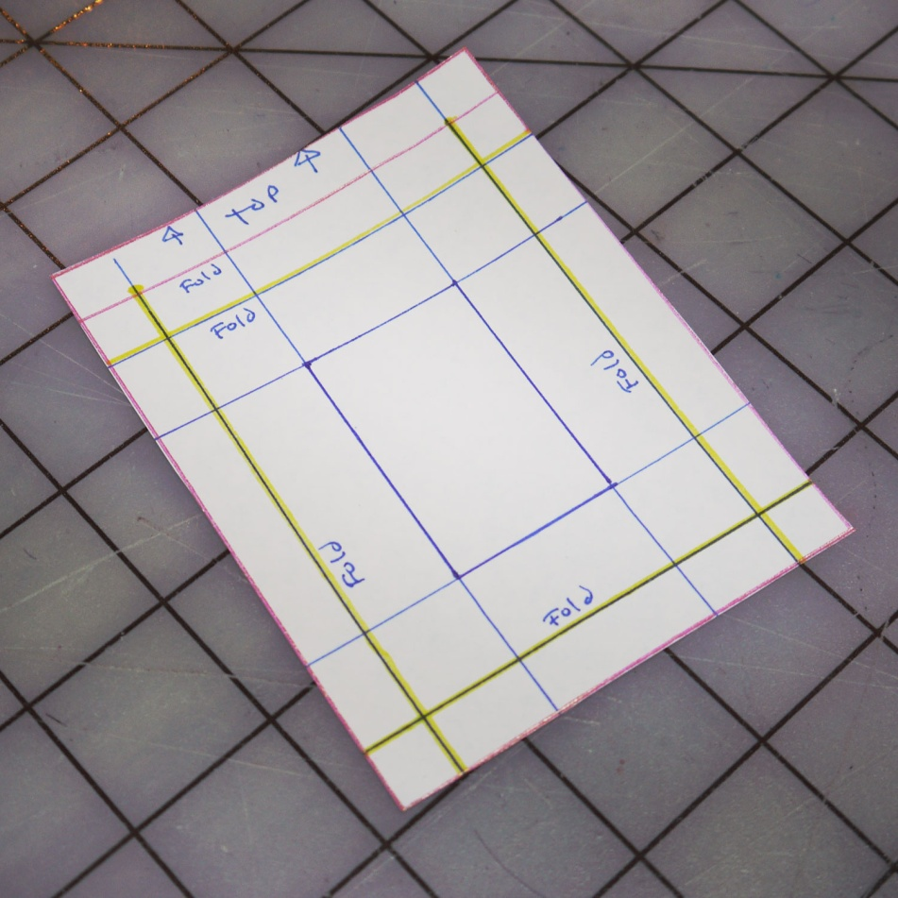
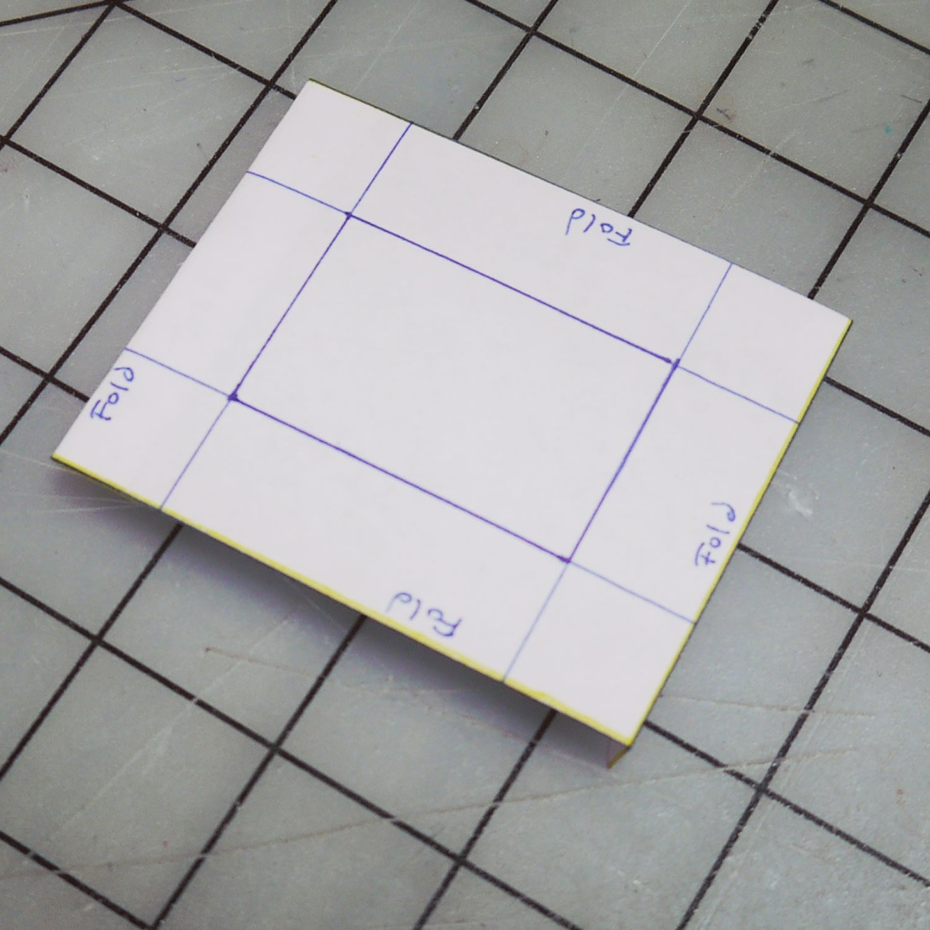
5.
Now cut the pattern out. This is what it will look like – it’s just a rectangle. You can make a pattern by just adding all the necessary measurements and drawing a rectangle, but if you are new to sewing it will help to have a pattern with markings to refer to.
6.
This is what the pattern looks like when all of the seam allowances are folded in. This is what size the finished pocket will be.

Slide 5
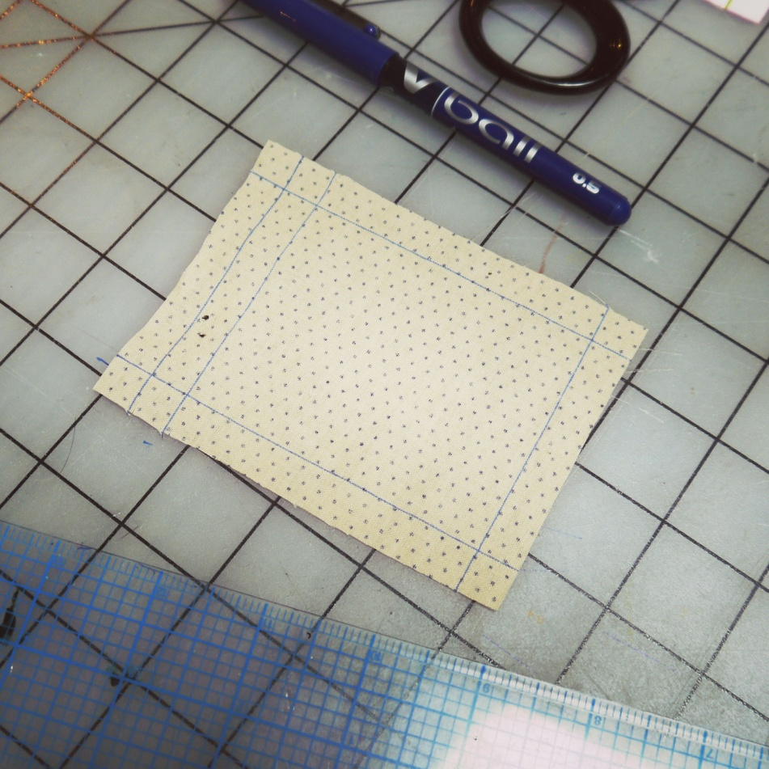
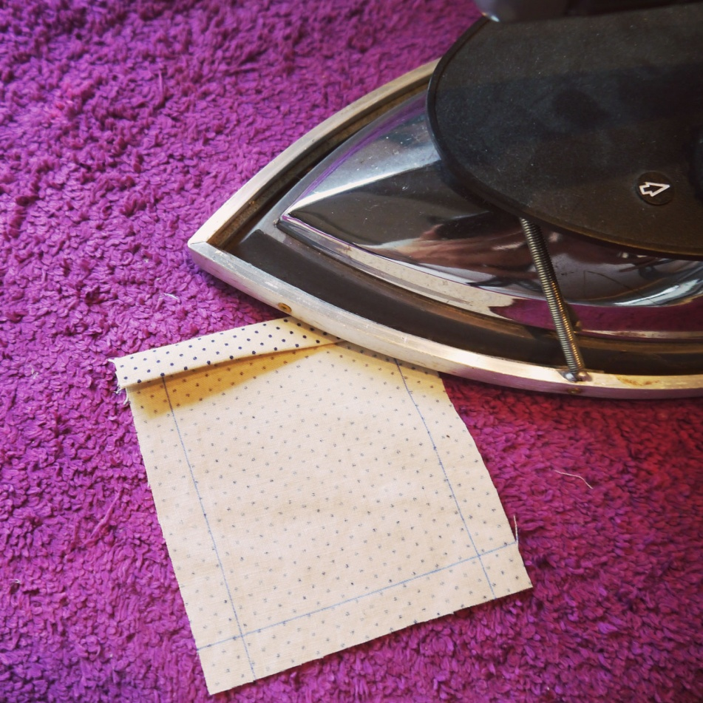
7.
Now pin your pattern onto your fabric and cut out around it. Make sure that the pattern is going with the grain of the fabric. This means the top edge will be perpendicular to the selvedge .What you will have is an unmarked rectangle. If it helps you, you can use the ruler to trace on the seam allowance lines so you will know where to fold the pocket.
8.
Now it’s time to finish the top edge of the pocket. Fold down the first fold line of the pocket top edge and press it with an iron. Then fold it again and press it so you have a double fold, with the raw edge of the fabric being sandwiched inside.

Slide 6
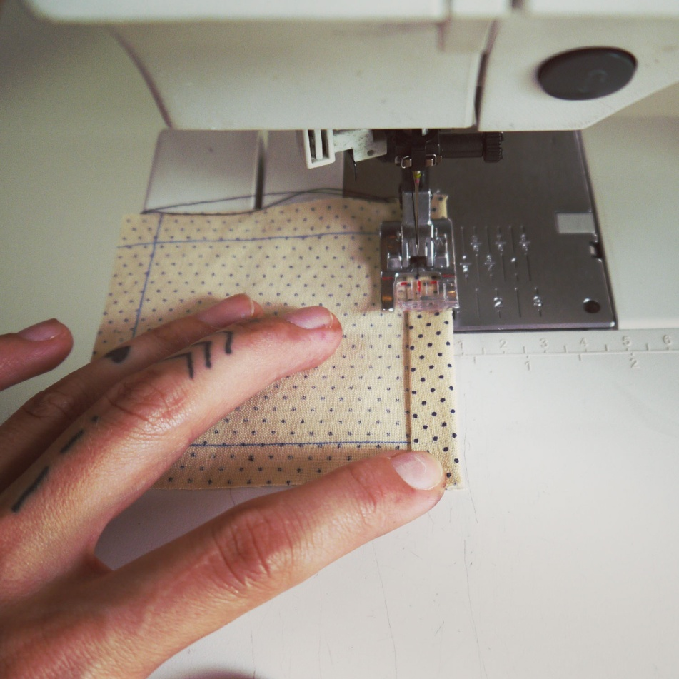
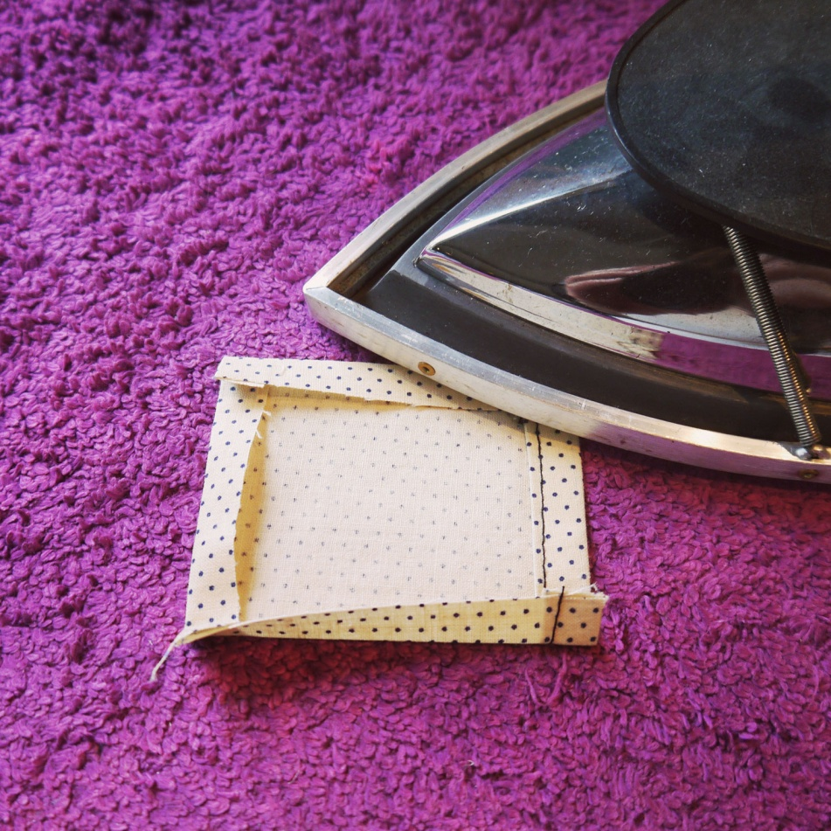
9.
Now sew across the top edge to secure it.
10.
Next, fold in and press the other seam allowances. Do the bottom edge first, and then the two sides.

Slide 7
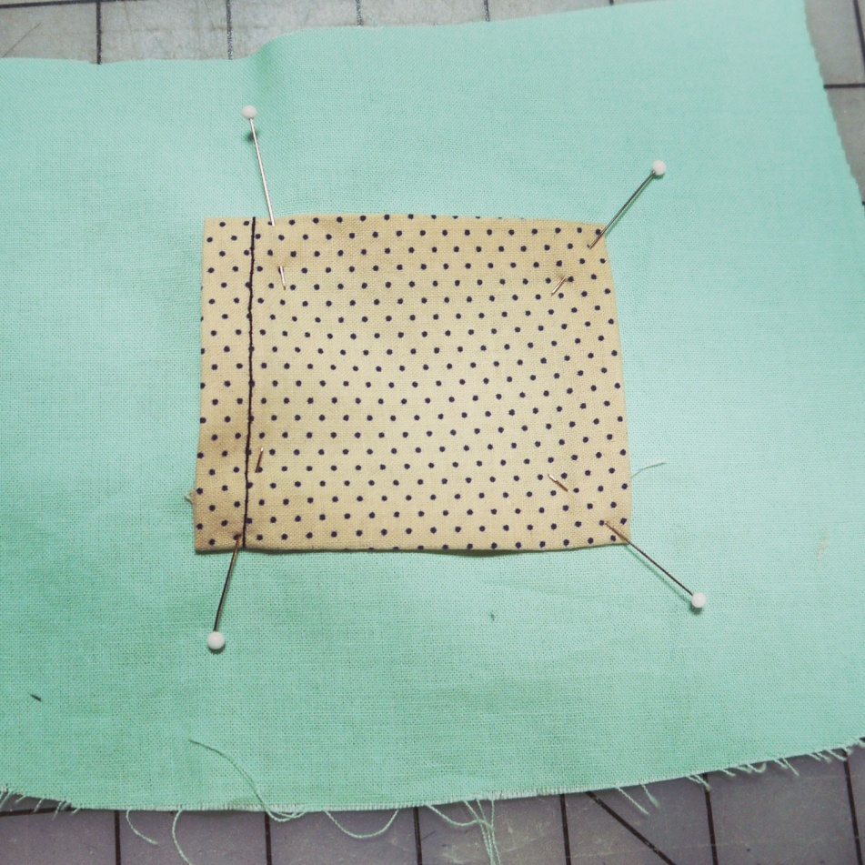
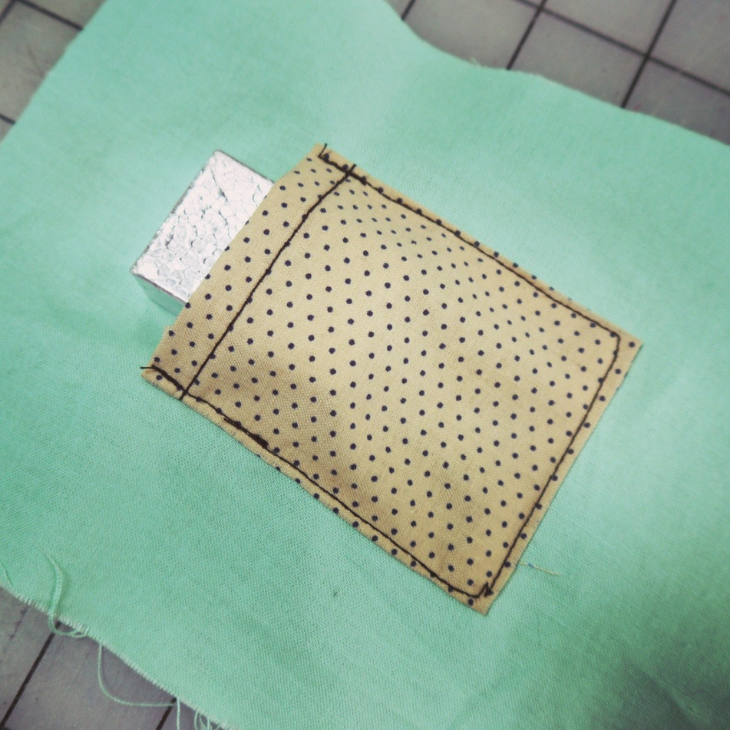
11.
Pin the folded and pressed pocket piece onto the fabric you want to sew it onto. If this is a garment, try it on first and mark with a pencil where it should go. Use a ruler or measuring tape to make sure it’s straight.
12.
Then sew around the remaining three sides of the pocket, leaving the top edge open. Make sure to backstitch at the beginning and end of your seam so that it won’t unravel. Now your pocket is finished!

